Slide 1
Genome Browser 1 Tools and Tables
HUGEN 2073
Genomic Data Visualization & Integration
Slides adapted from Ryan L. Minster, PhD, MSIS

Slide 2
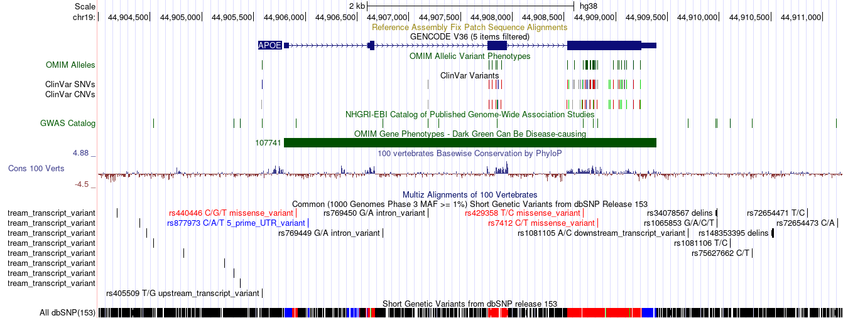

Slide 3
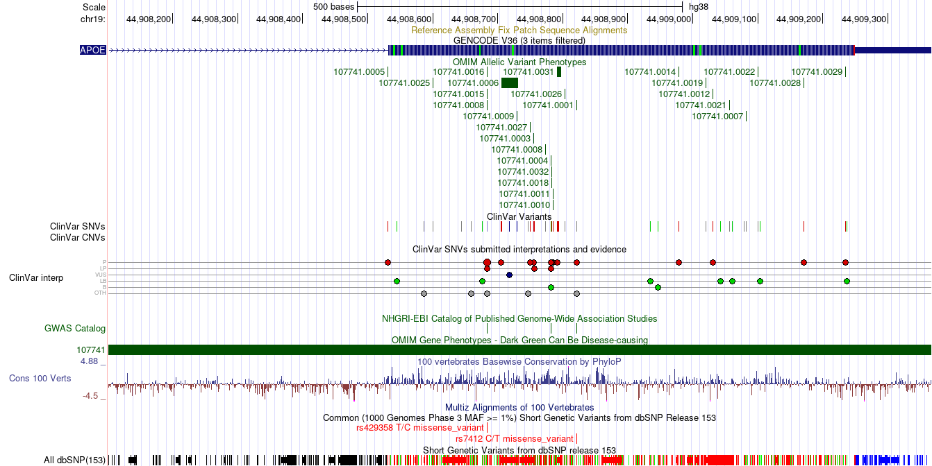

Slide 4
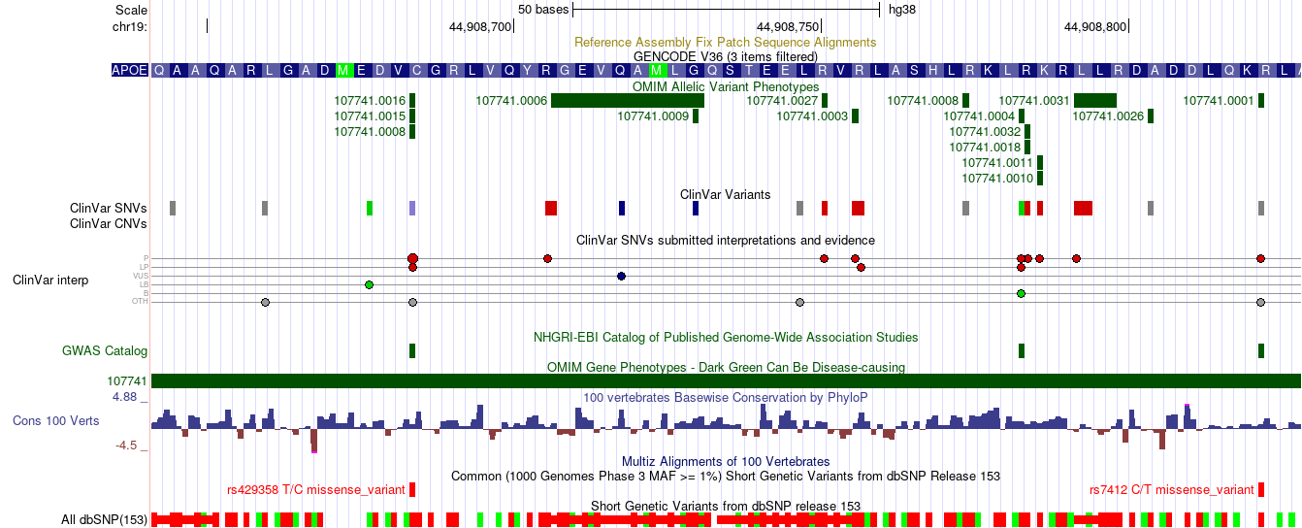

Slide 5
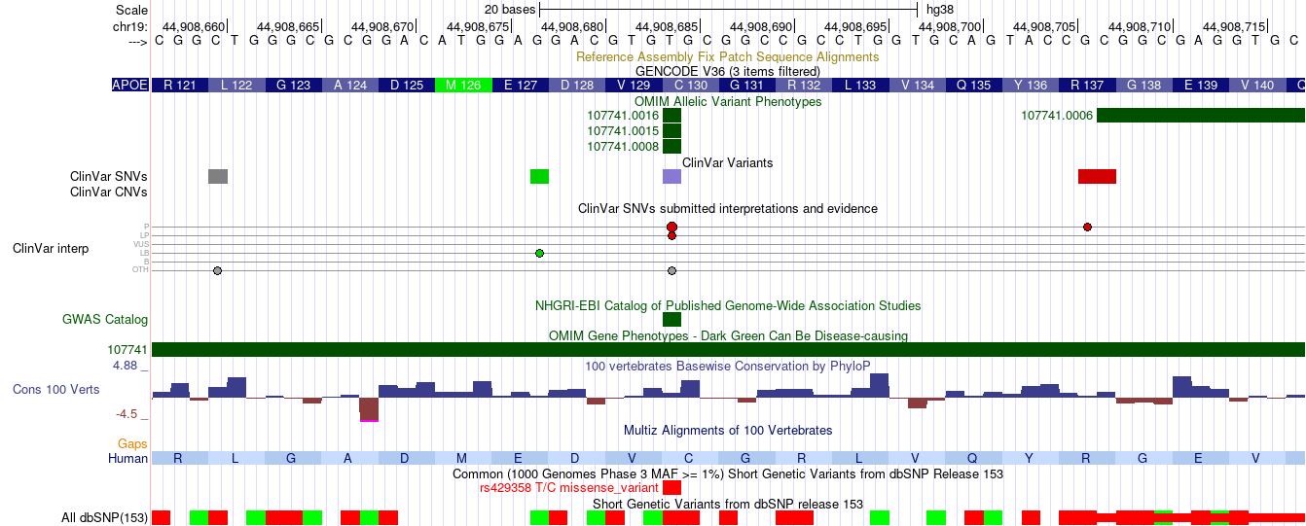

Slide 6
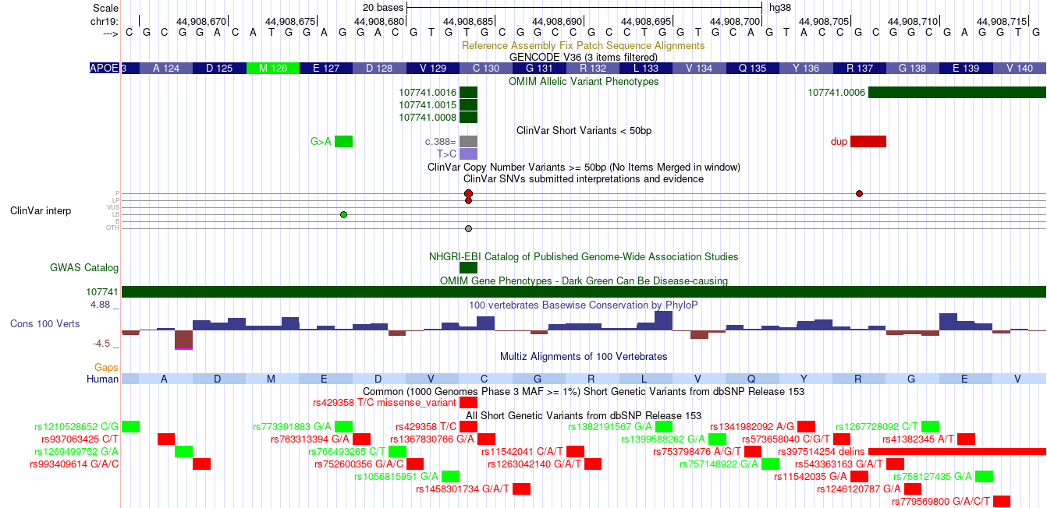

Slide 7
University of California at Santa Cruz (UCSC) Genome Browser
An on-line, and downloadable, genome browser
An interactive website offering access to genome sequence data from a variety of vertebrate and invertebrate species and major model organisms, integrated with a large collection of aligned annotations.
An open-source, web-based tool suite built on top of a MySQL database for rapid visualization, examination, and querying of the data at many levels.
The Genome Browser Database, browsing tools, downloadable data files, and documentation can all be found on the UCSC Genome Bioinformatics website.

Slide 8
Citations
Kent et al. The human genome browser at UCSC. Genome Res 12, 996 (2002) https://doi.org/10.1101/gr.229102
Kuhn et al. The UCSC Genome Browser Database: update 2009. Nucleic Acids Res 37, D755 (2009) https://doi.org/10.1093/nar/gkn875
Fujita et al. The UCSC Genome Browser database: update 2011. Nucleic Acids Res 39, D876 (2011) https://doi.org/10.1093/nar/gkq963
Lee et al. UCSC Genome Browser enters 20th year. Nucleic Acids Res 48, D756 (2020). https://doi.org/10.1093/nar/gkz1012

Slide 9
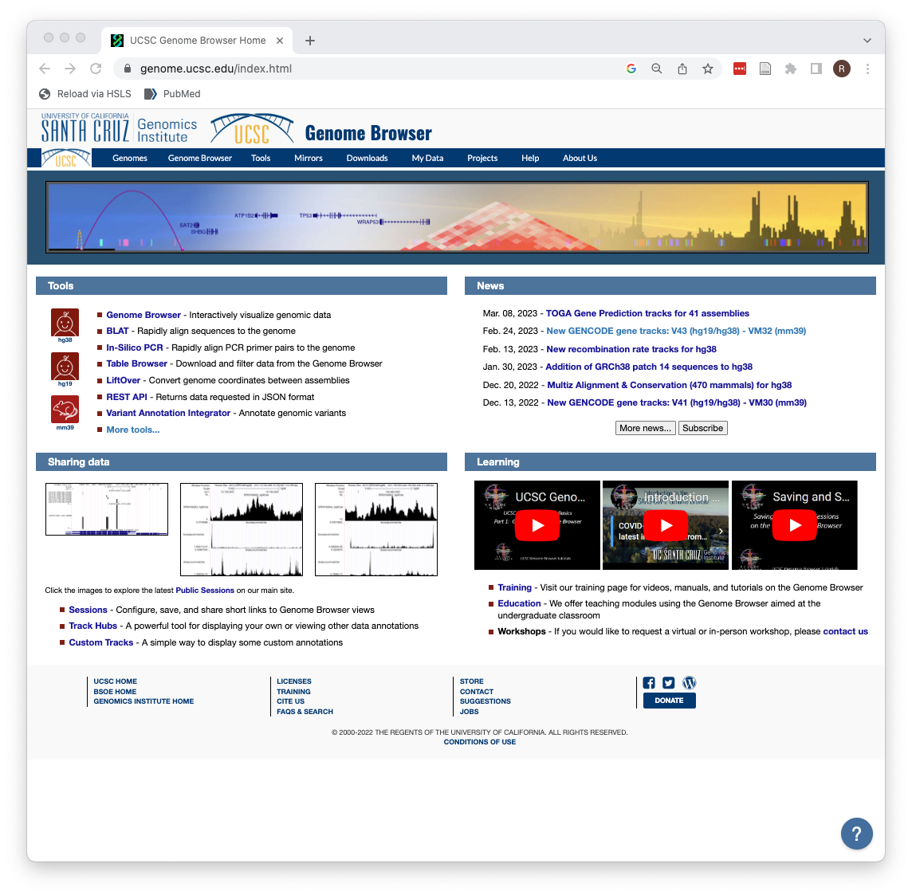

Slide 10
Features
Visual Interface (“Genome Browser” on the landing page)
Underlying Data Tables (“Table Browser”)
Two types of data integrators
Site Based (“Variant Annotation Integrator”)
Range Based (“Data Integrator”)
Desktop version [“Genome Browser in a Box (GBiB)”]
Genome coordinate conversion (“LiftOver”)
Ability to add custom tracks (”Track Hubs”)

Slide 11
Features
Visual Interface (“Genome Browser” on the landing page)
Underlying Data Tables (“Table Browser”)
Two types of data integrators
Site Based (“Variant Annotation Integrator”)
Range Based (“Data Integrator”)
Desktop version [“Genome Browser in a Box (GBiB)”]
Genome coordinate conversion (“LiftOver”)
Ability to add custom tracks (”Track Hubs”)

Slide 12
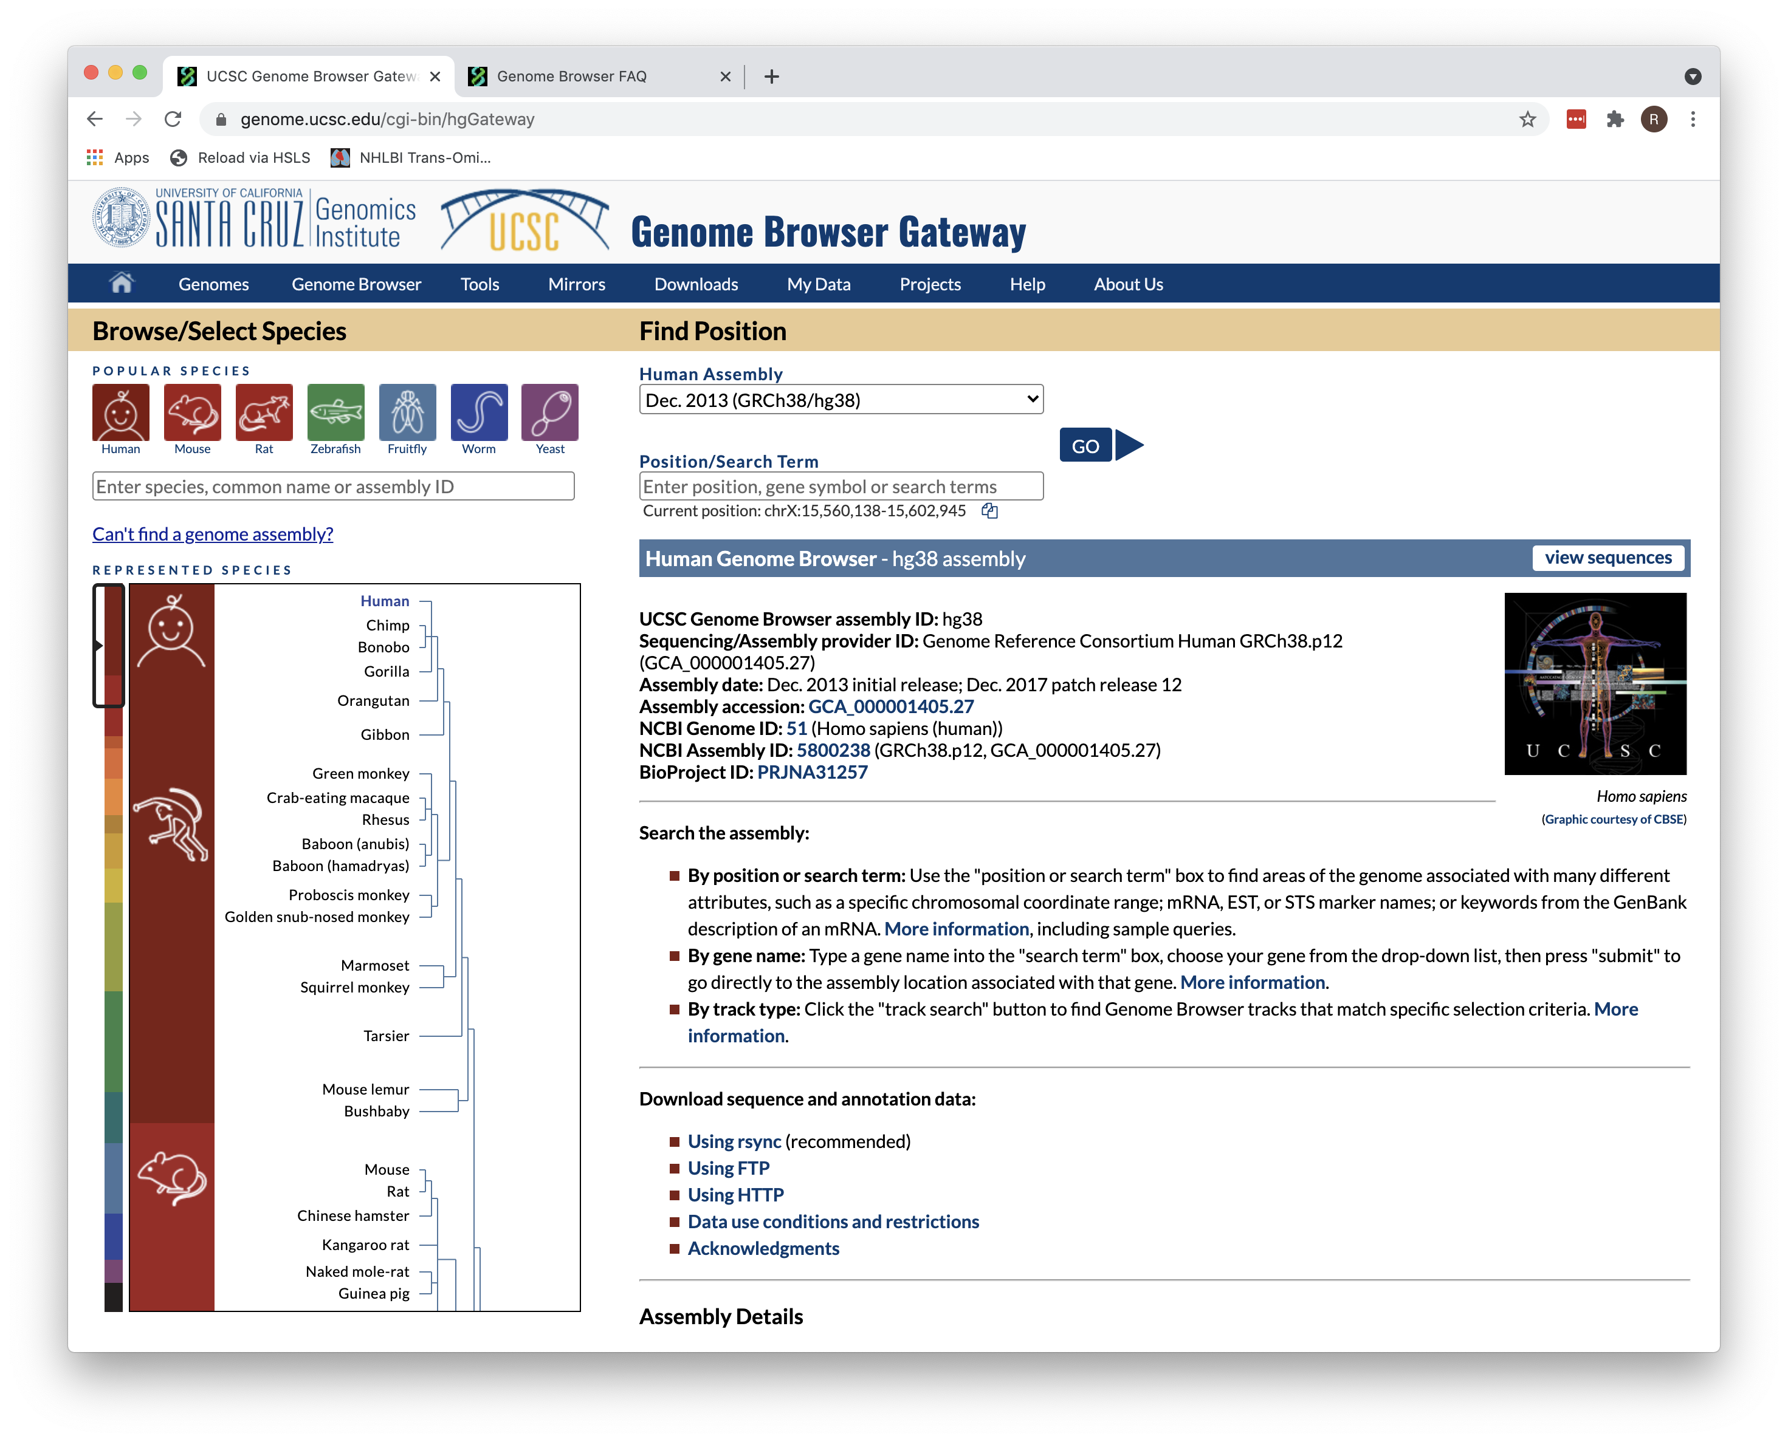
Visual Interface
Choose organism and assembly
Enter a search term (optional): • gene symbol • variant ID • range • chrN:0-0

Slide 13
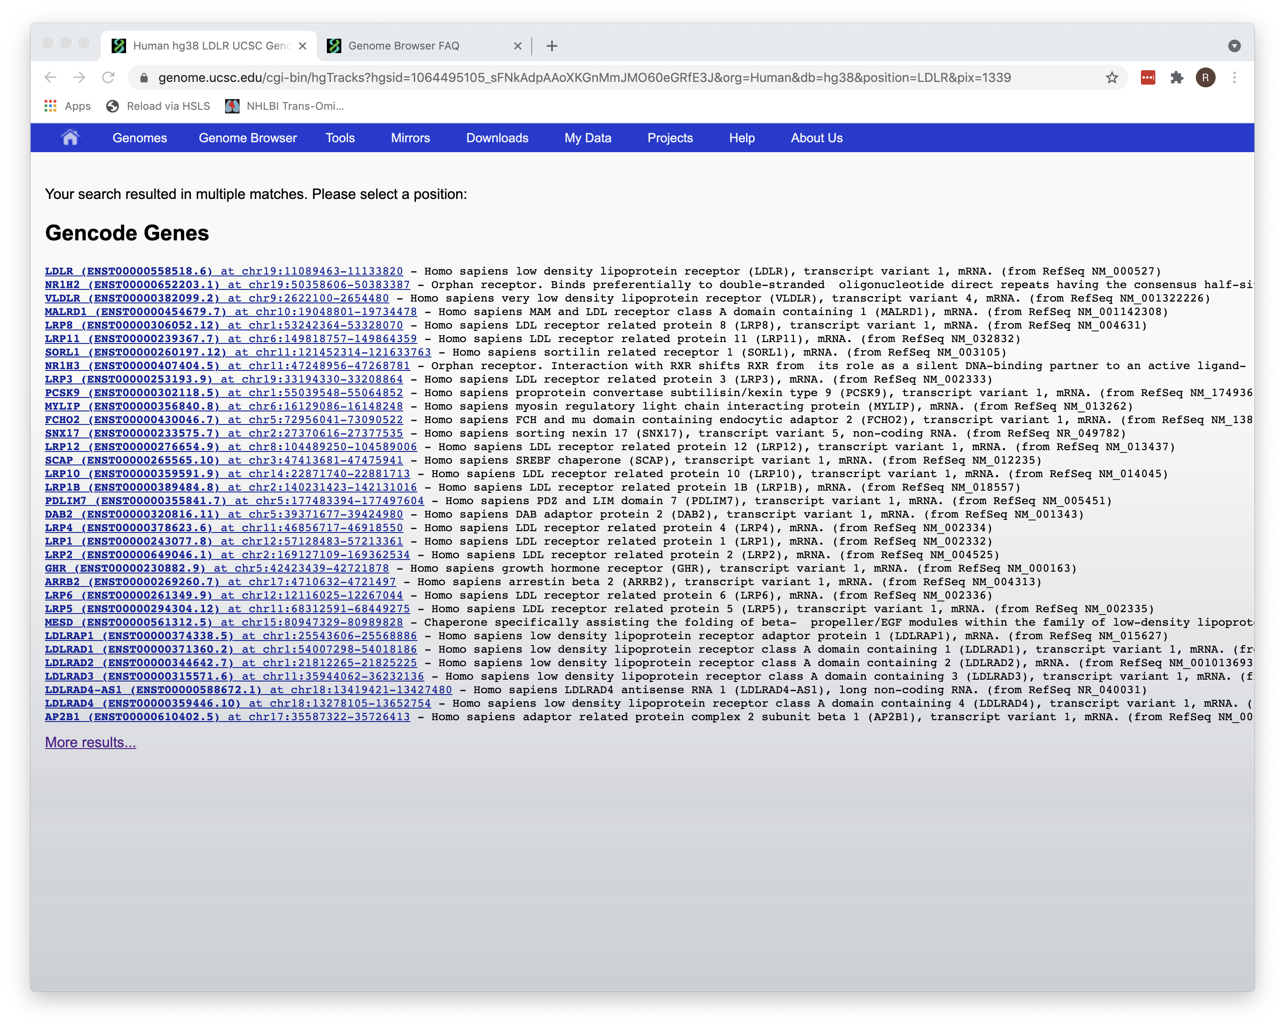
Search Results

Slide 14
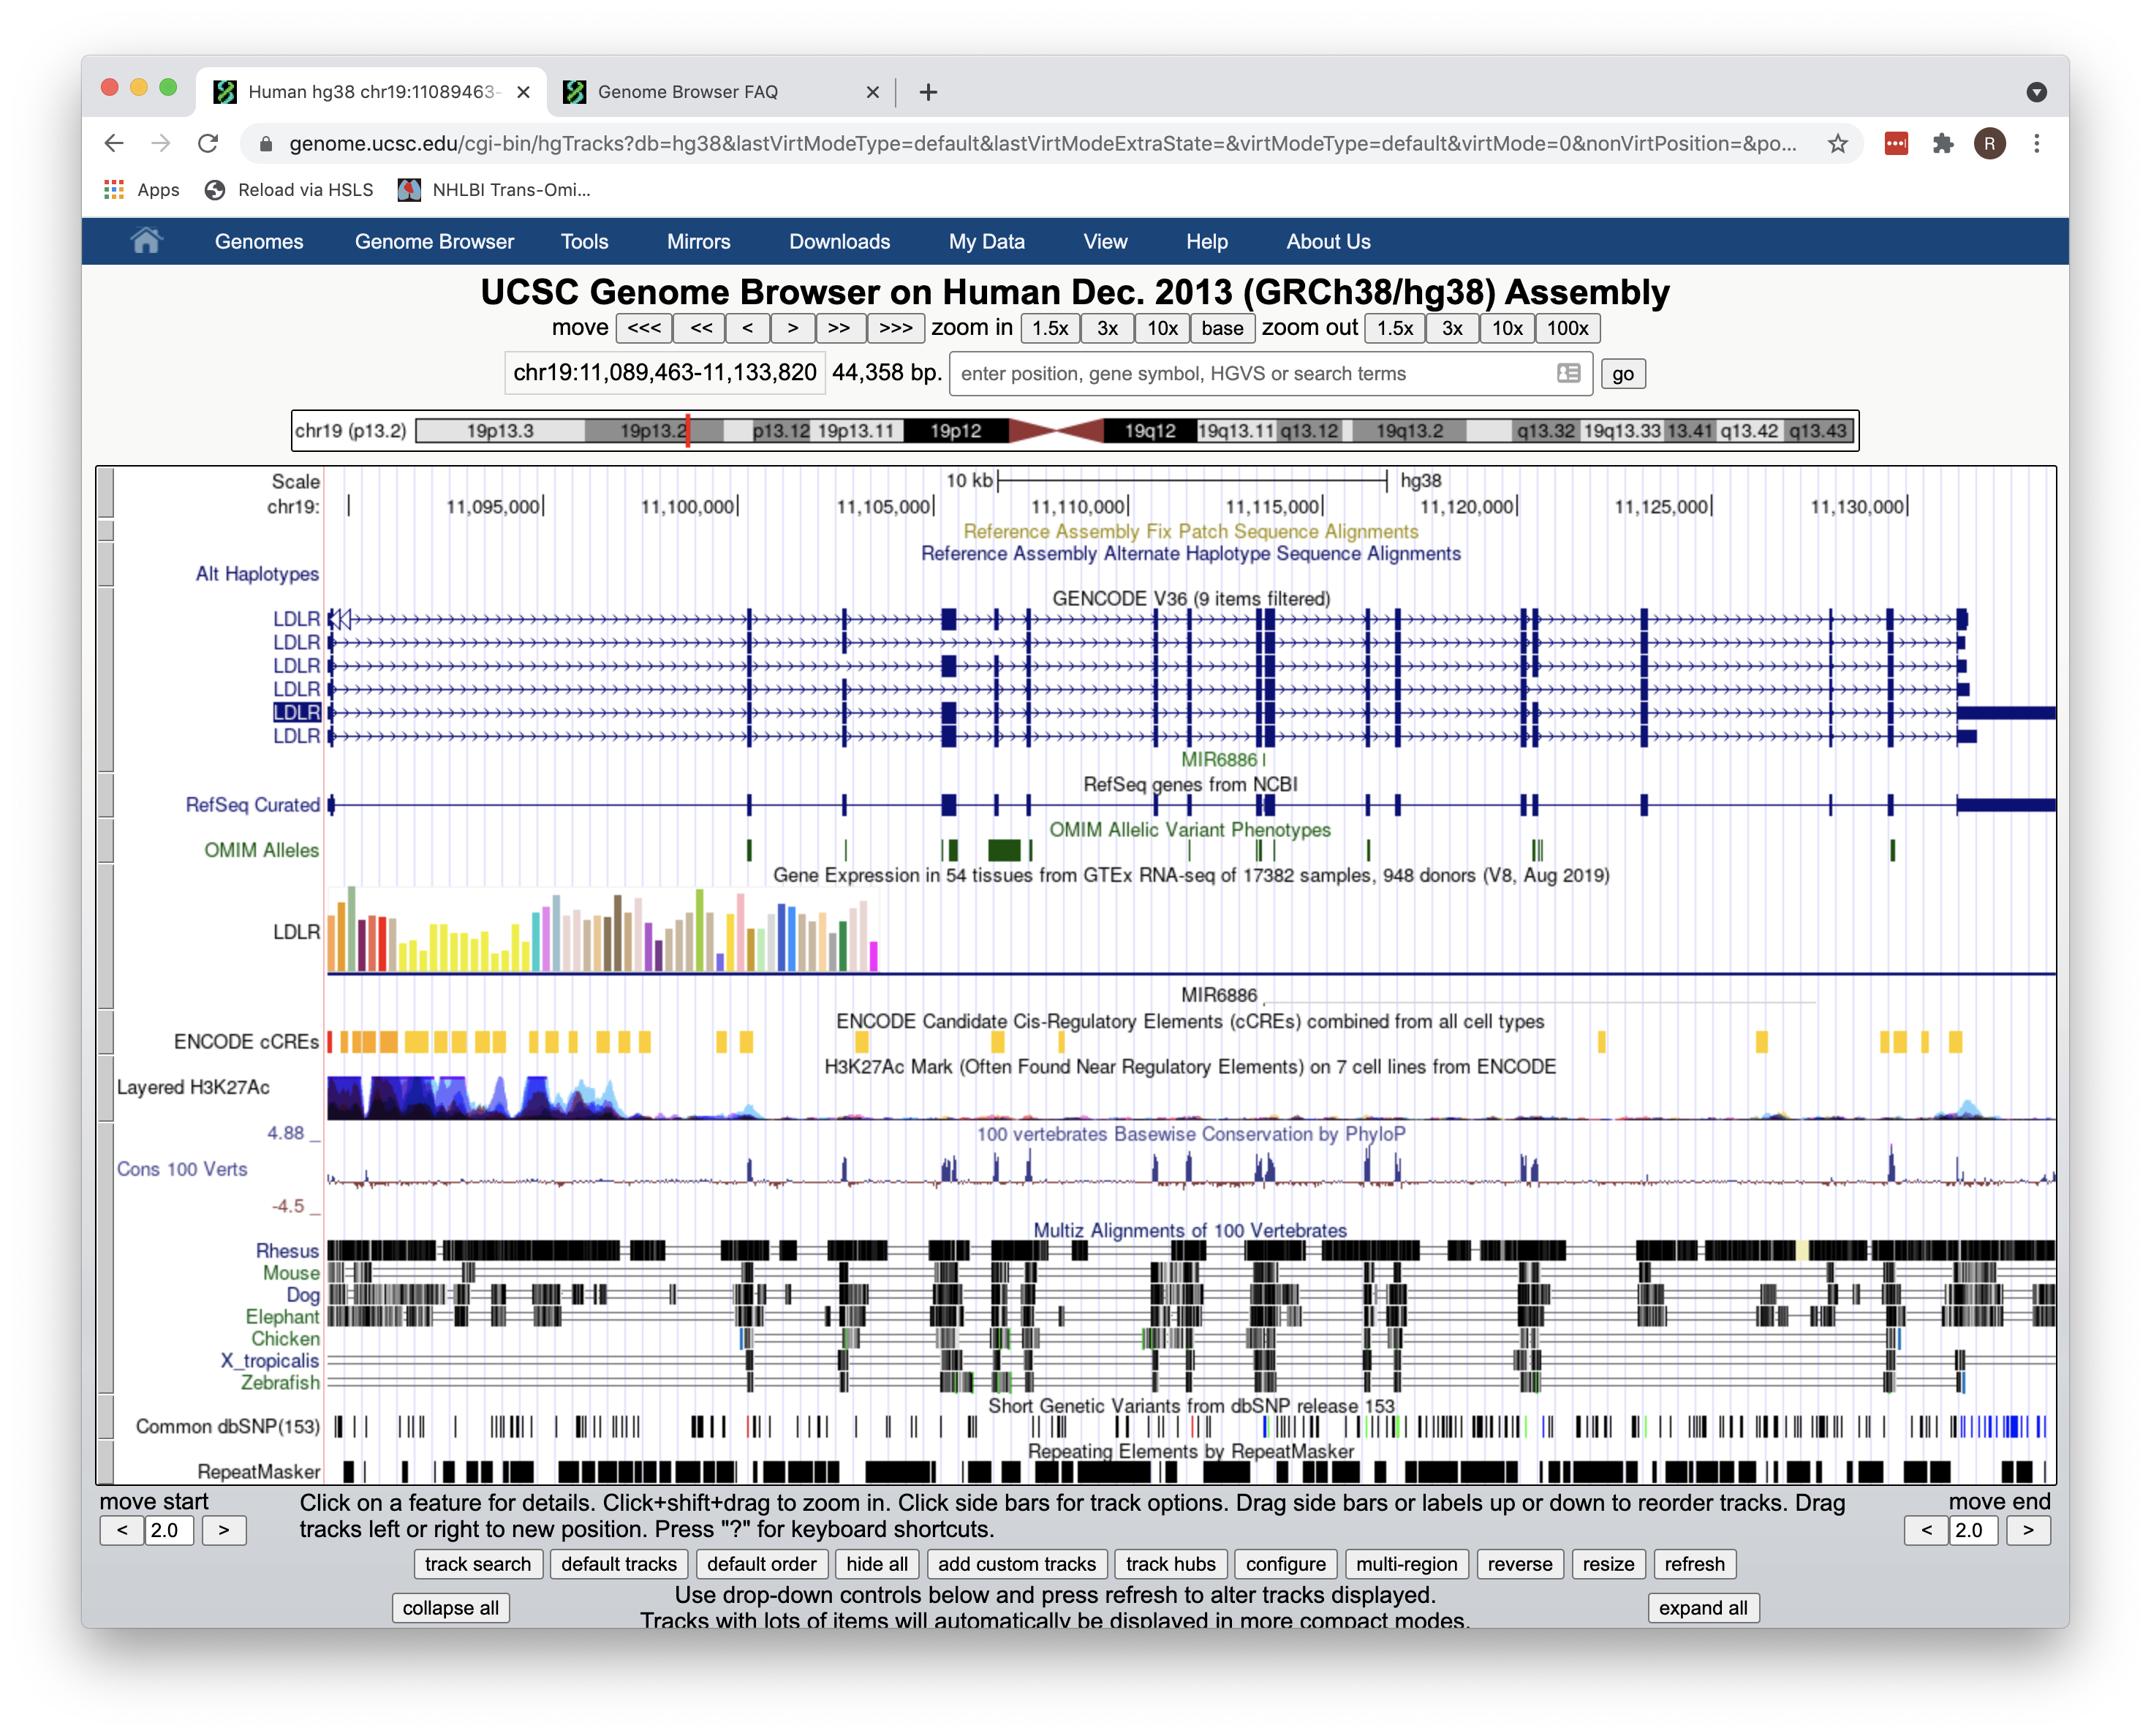
Visual

Slide 15
Tracks
Sets of data organized into categories
Categories: Mapping and Sequencing, Genes and Gene Predictions, Phenotype and Literature, etc.
Each track is a display of a table of data
The display of each track can be altered on a variety of parameters

Slide 16
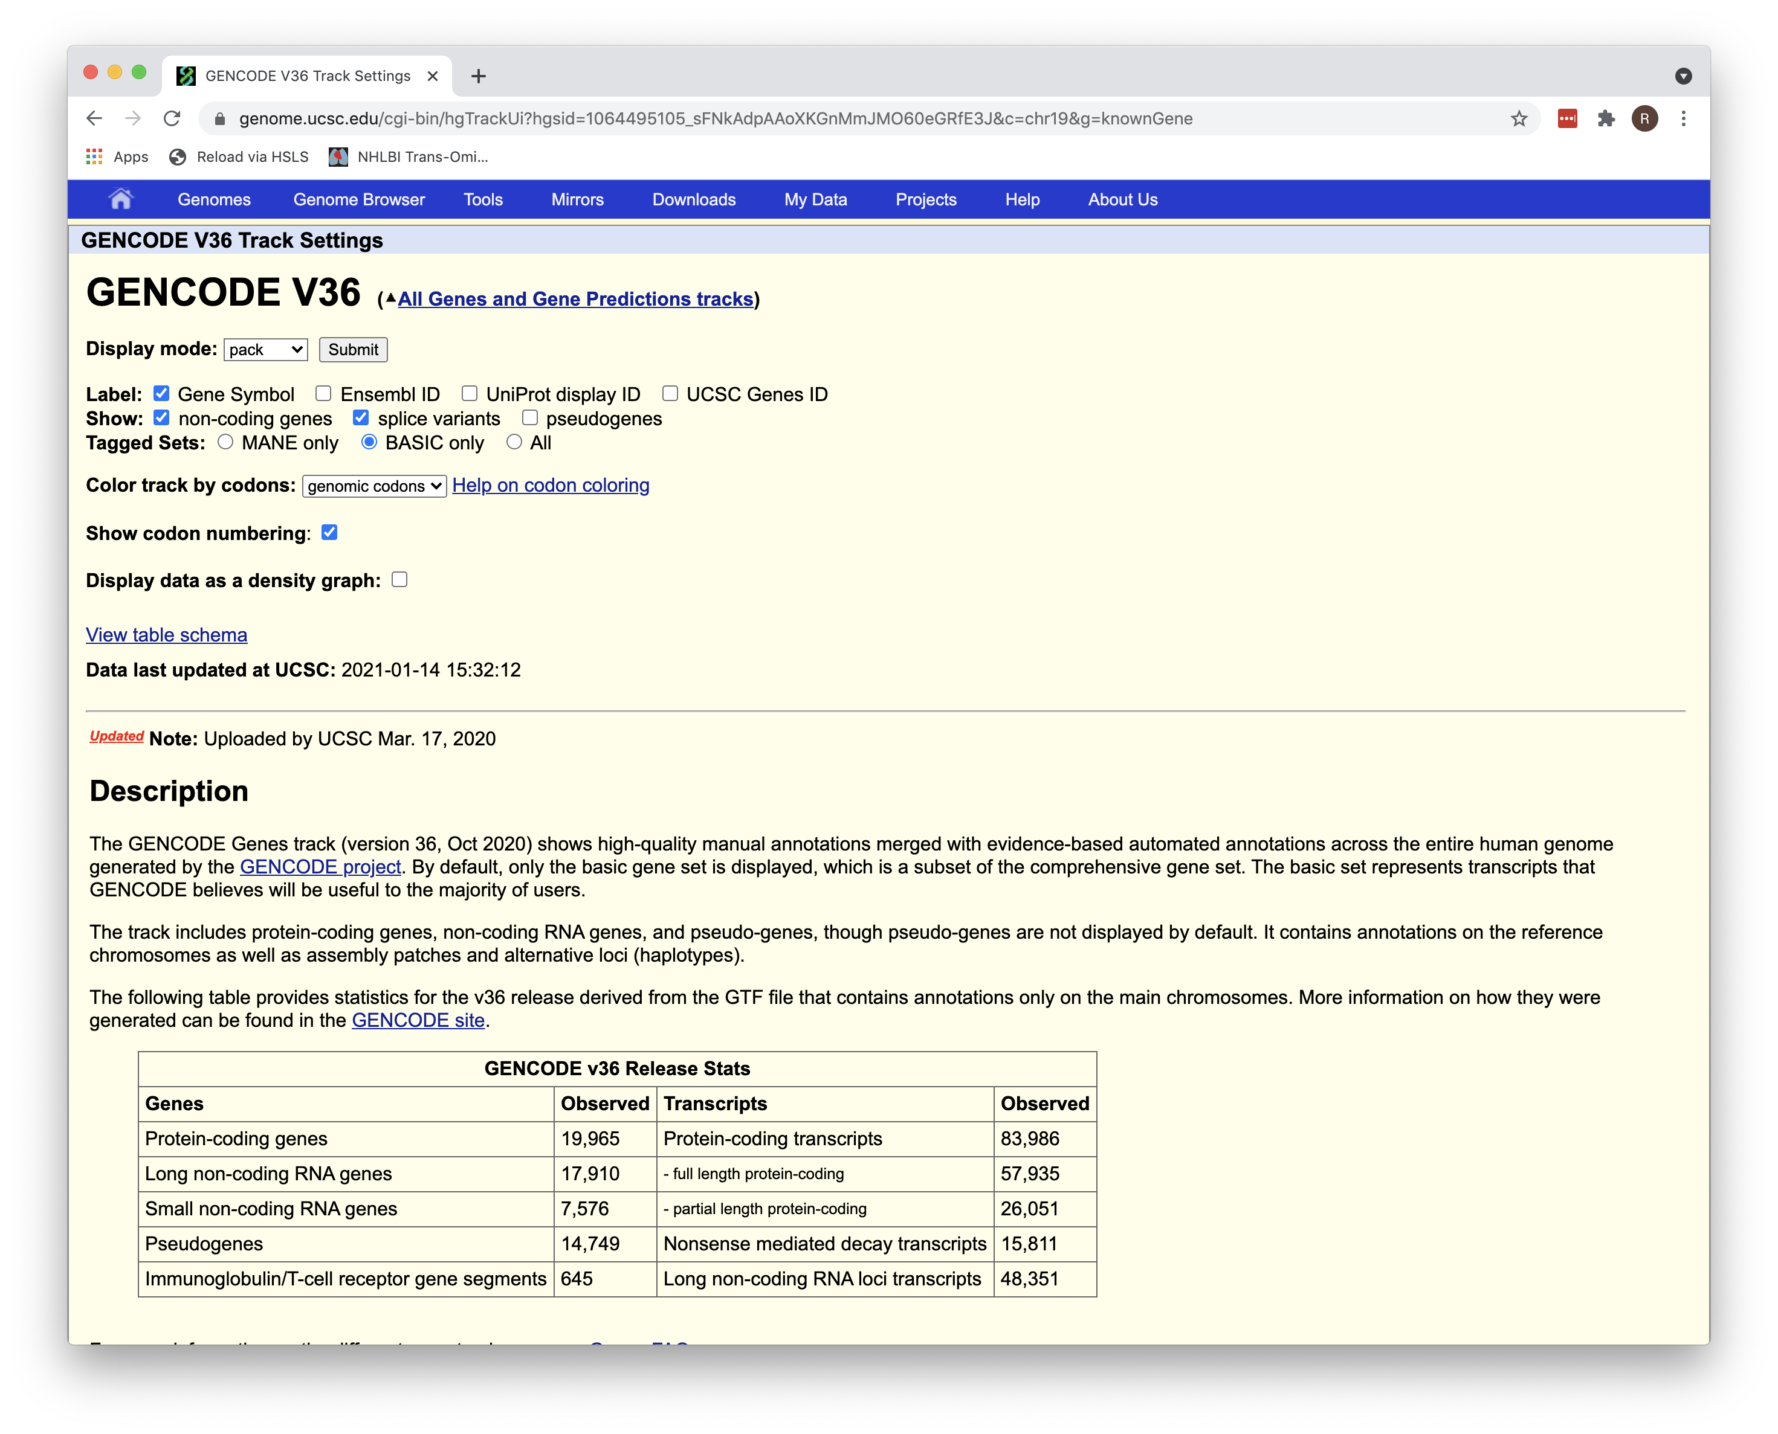
Track Settings

Slide 17
Underlying Table

Slide 18
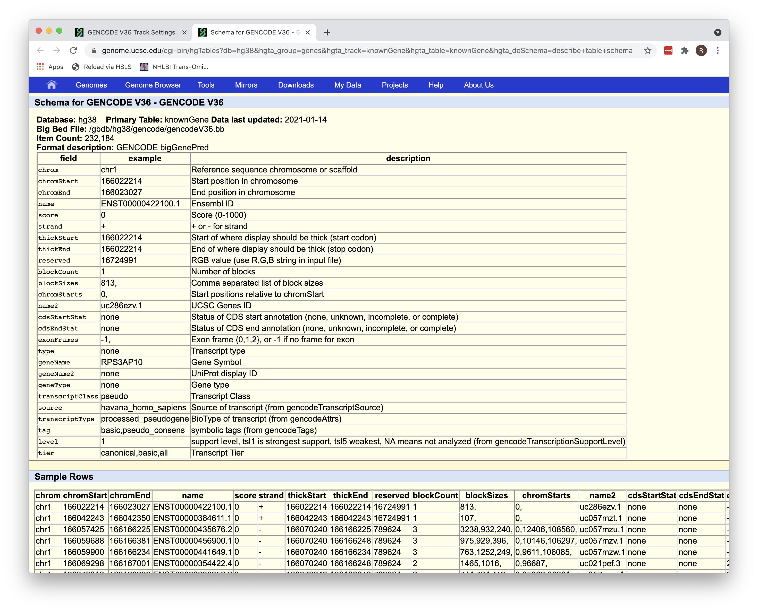
Table Schema
Schema = Design
Note: Database: hg38 Primary table: knownGene Fields: chrom, chromStart, etc. Example data

Slide 19
A Different Table Schema
Go back to Genome View and click on dbSNP 153
Schema links are at the far right of the subtracks

Slide 20
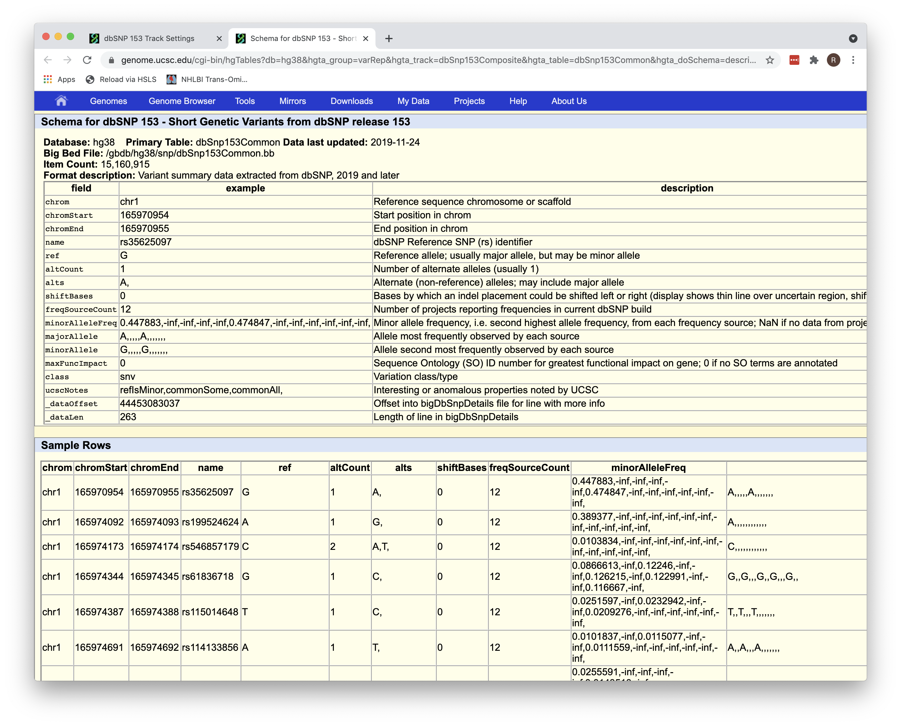
hg38
dbSnp153Common

Slide 21
Features
Visual Interface (“Genome Browser” on the landing page)
Underlying Data Tables (“Table Browser”)
Two types of data integrators
Site Based (“Variant Annotation Integrator”)
Range Based (“Data Integrator”)
Desktop version [“Genome Browser in a Box (GBiB)”]
Genome coordinate conversion (“LiftOver”)
Ability to add custom tracks (”Track Hubs”)

Slide 22
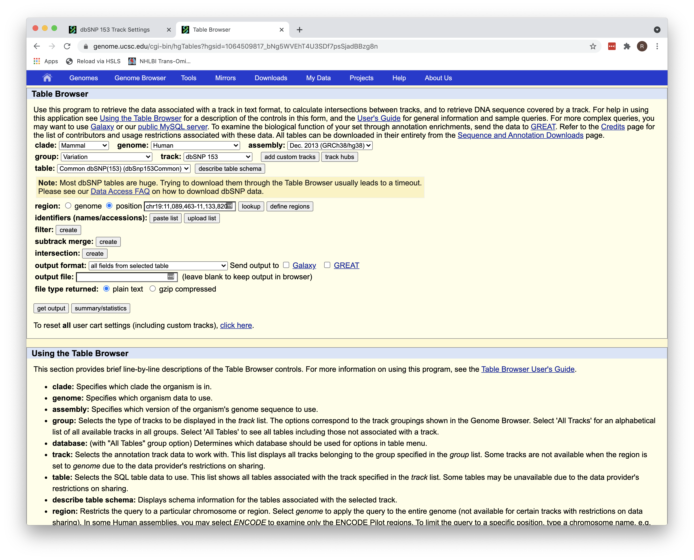
Table Browser

Slide 23
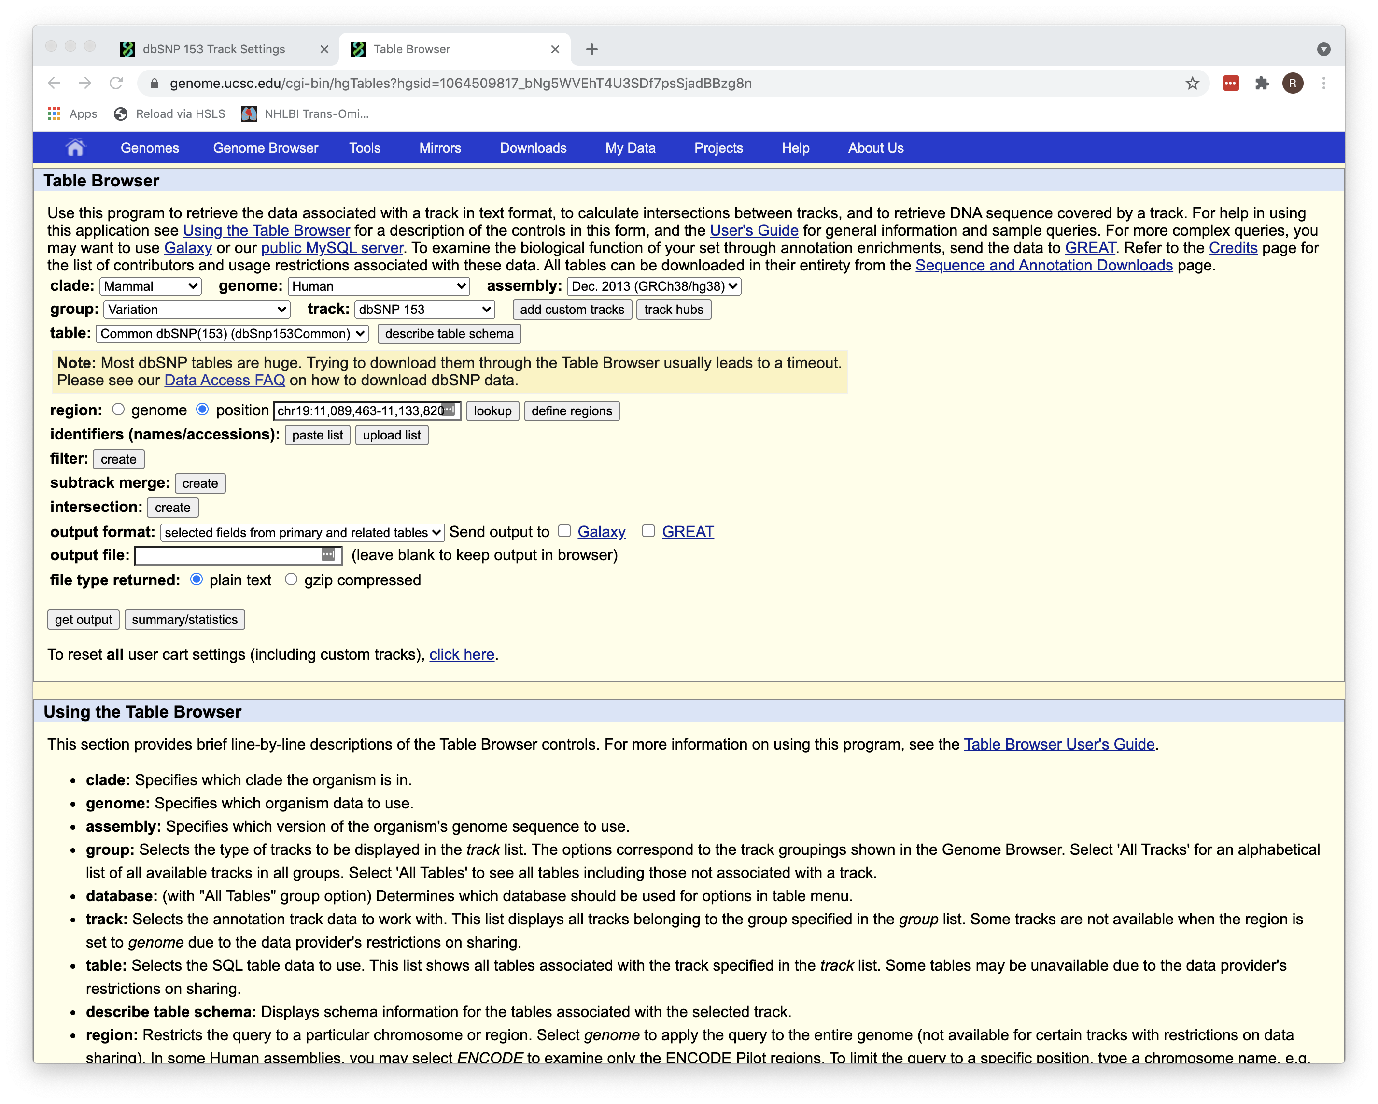
Select fields
then

Slide 24
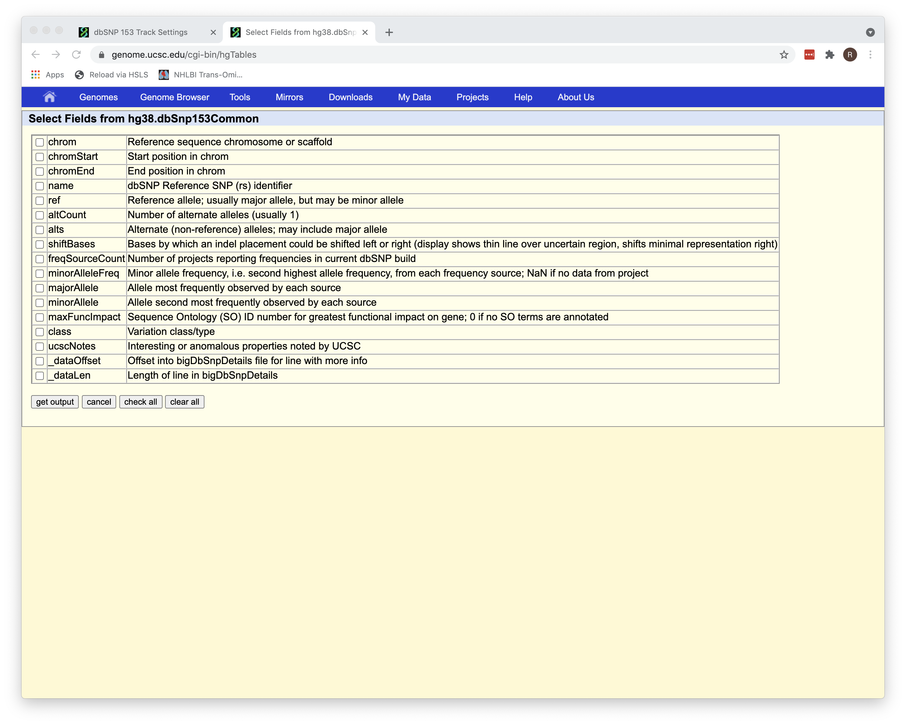
Select fields

Slide 25
Filter

Slide 26
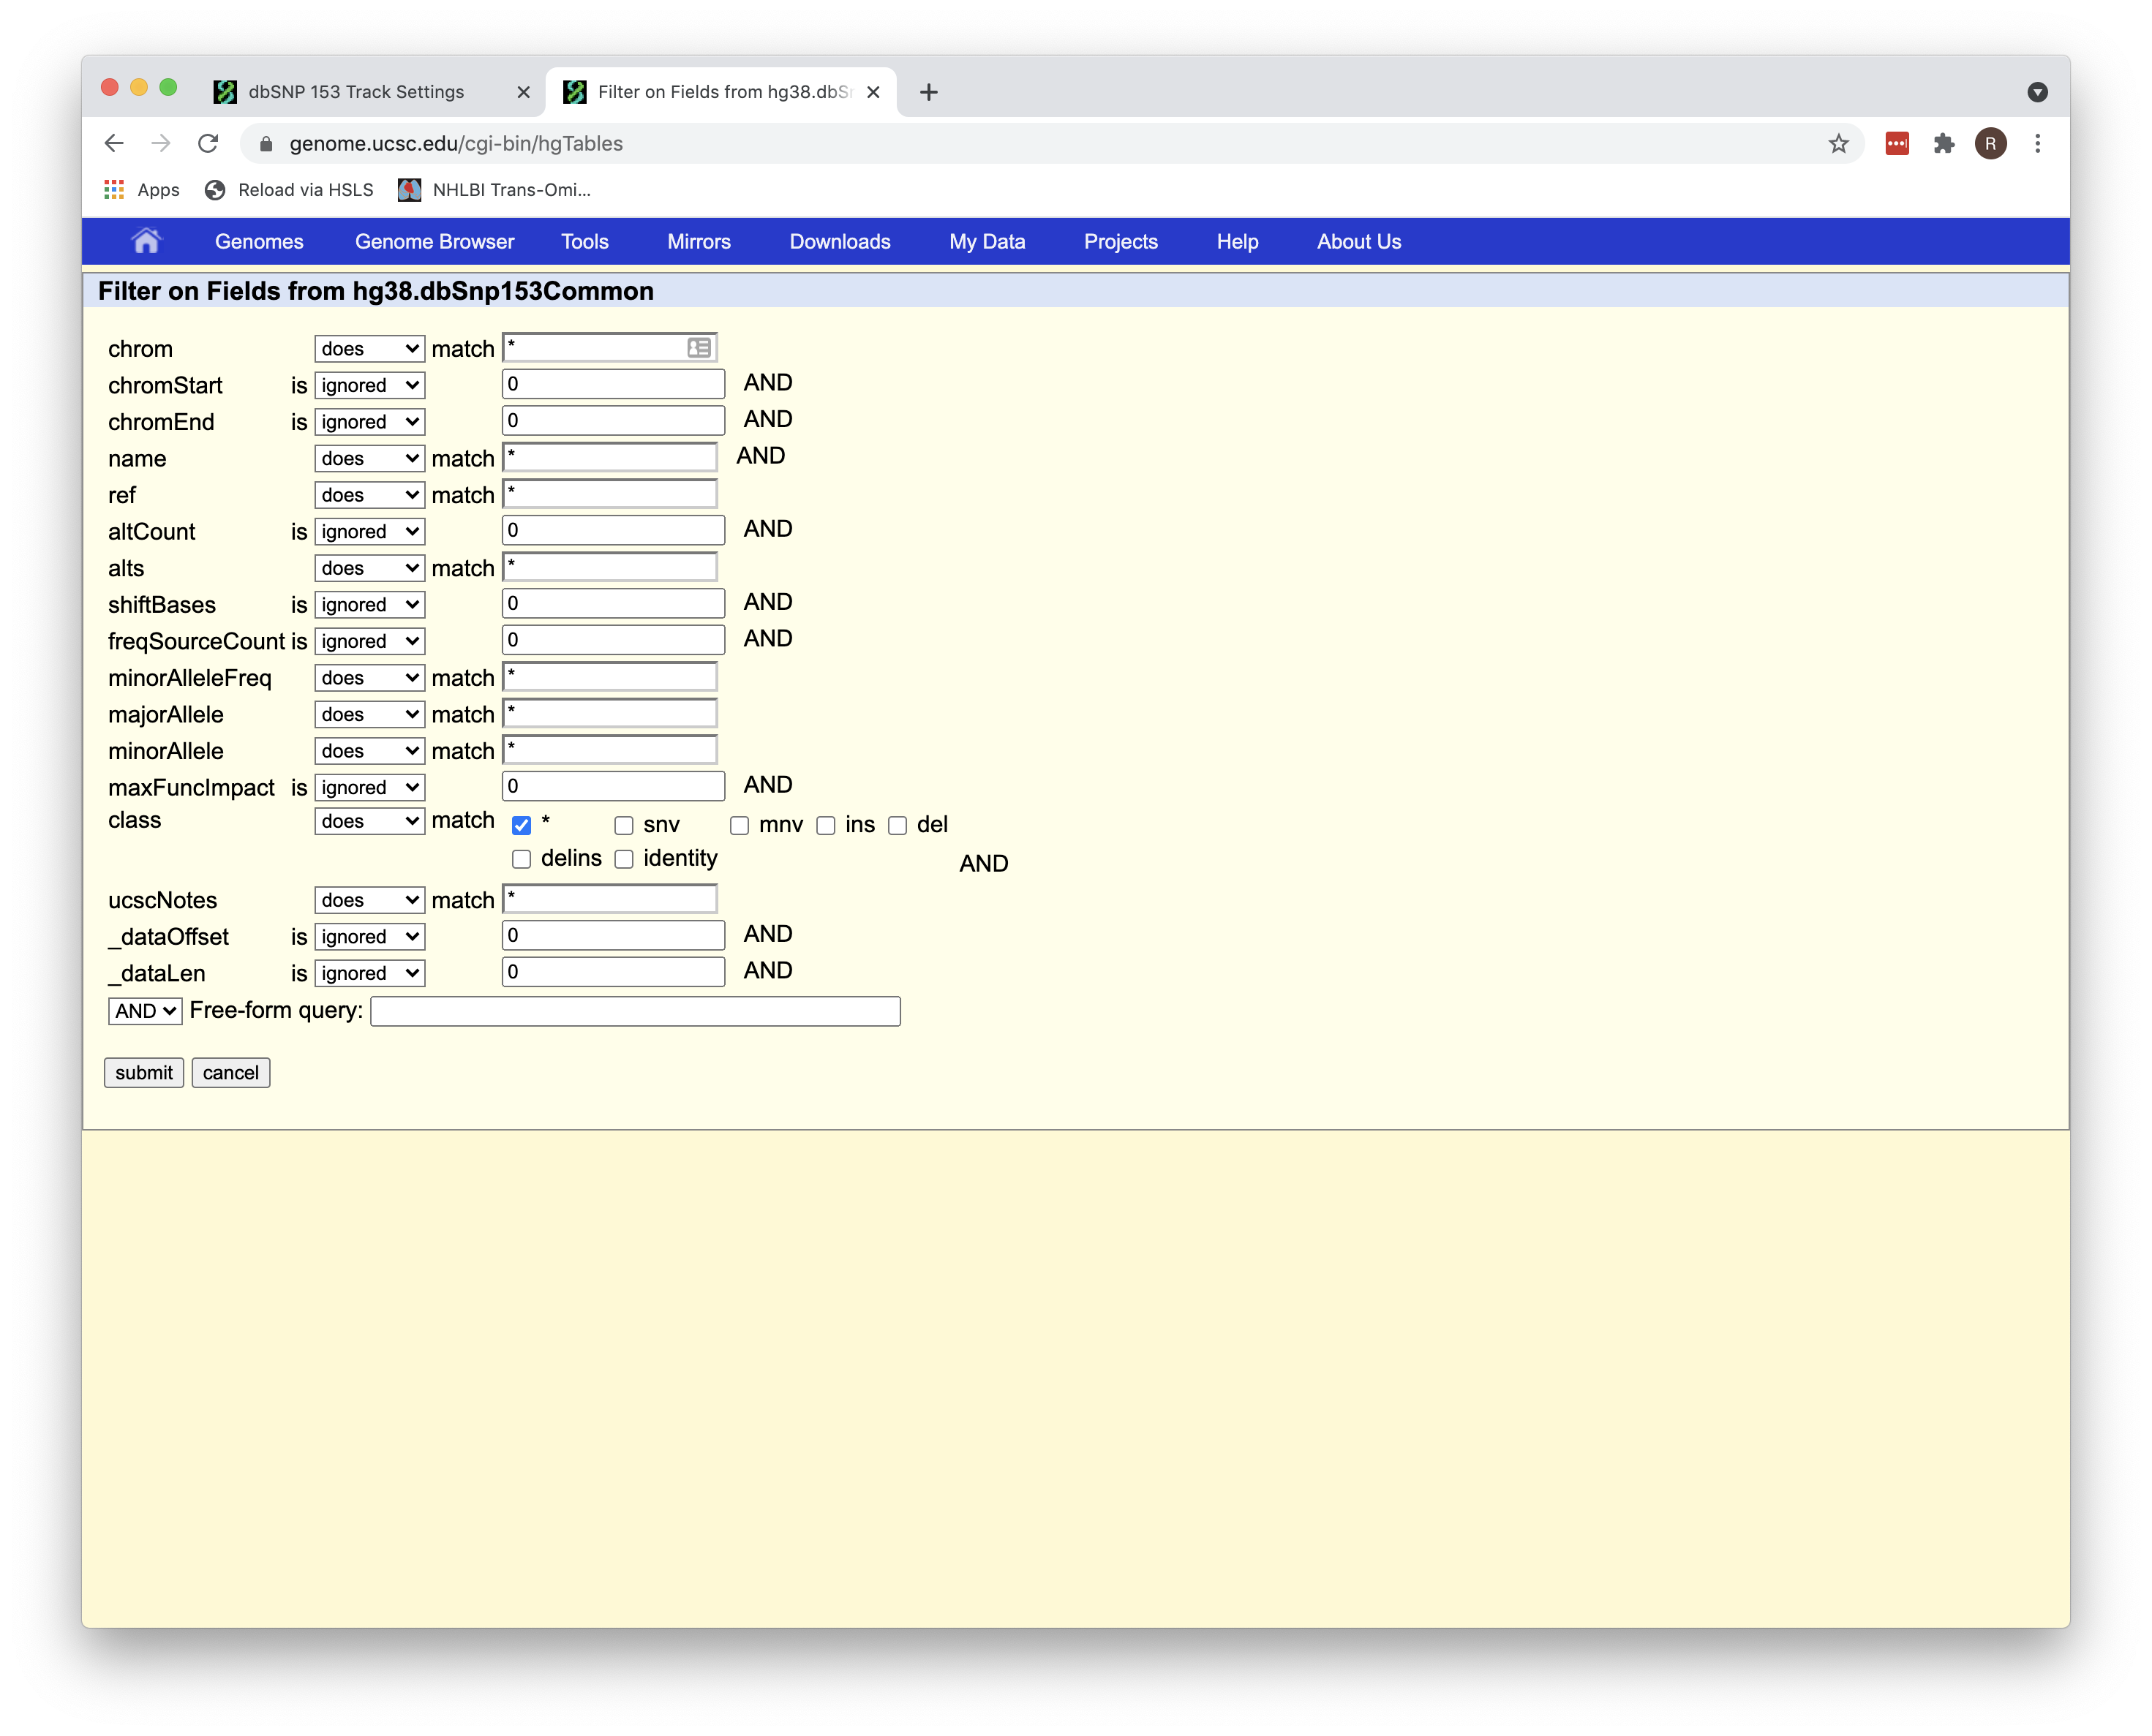
Filter

Slide 27
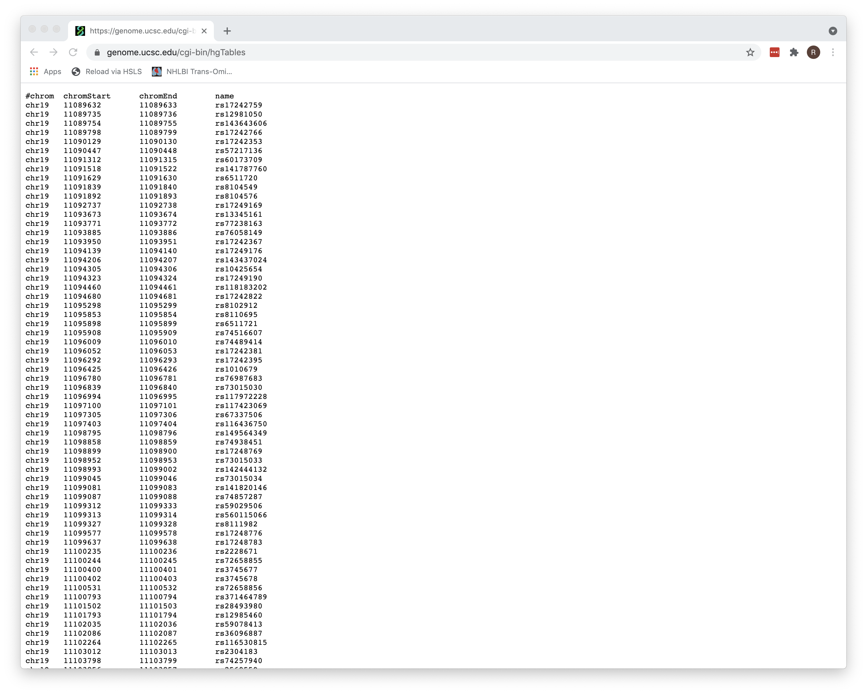
Output

Slide 28
Features
Visual Interface (“Genome Browser” on the landing page)
Underlying Data Tables (“Table Browser”)
Two types of data integrators
Site Based (“Variant Annotation Integrator”)
Range Based (“Data Integrator”)
Desktop version [“Genome Browser in a Box (GBiB)”]
Genome coordinate conversion (“LiftOver”)
Ability to add custom tracks (”Track Hubs”)

Slide 29
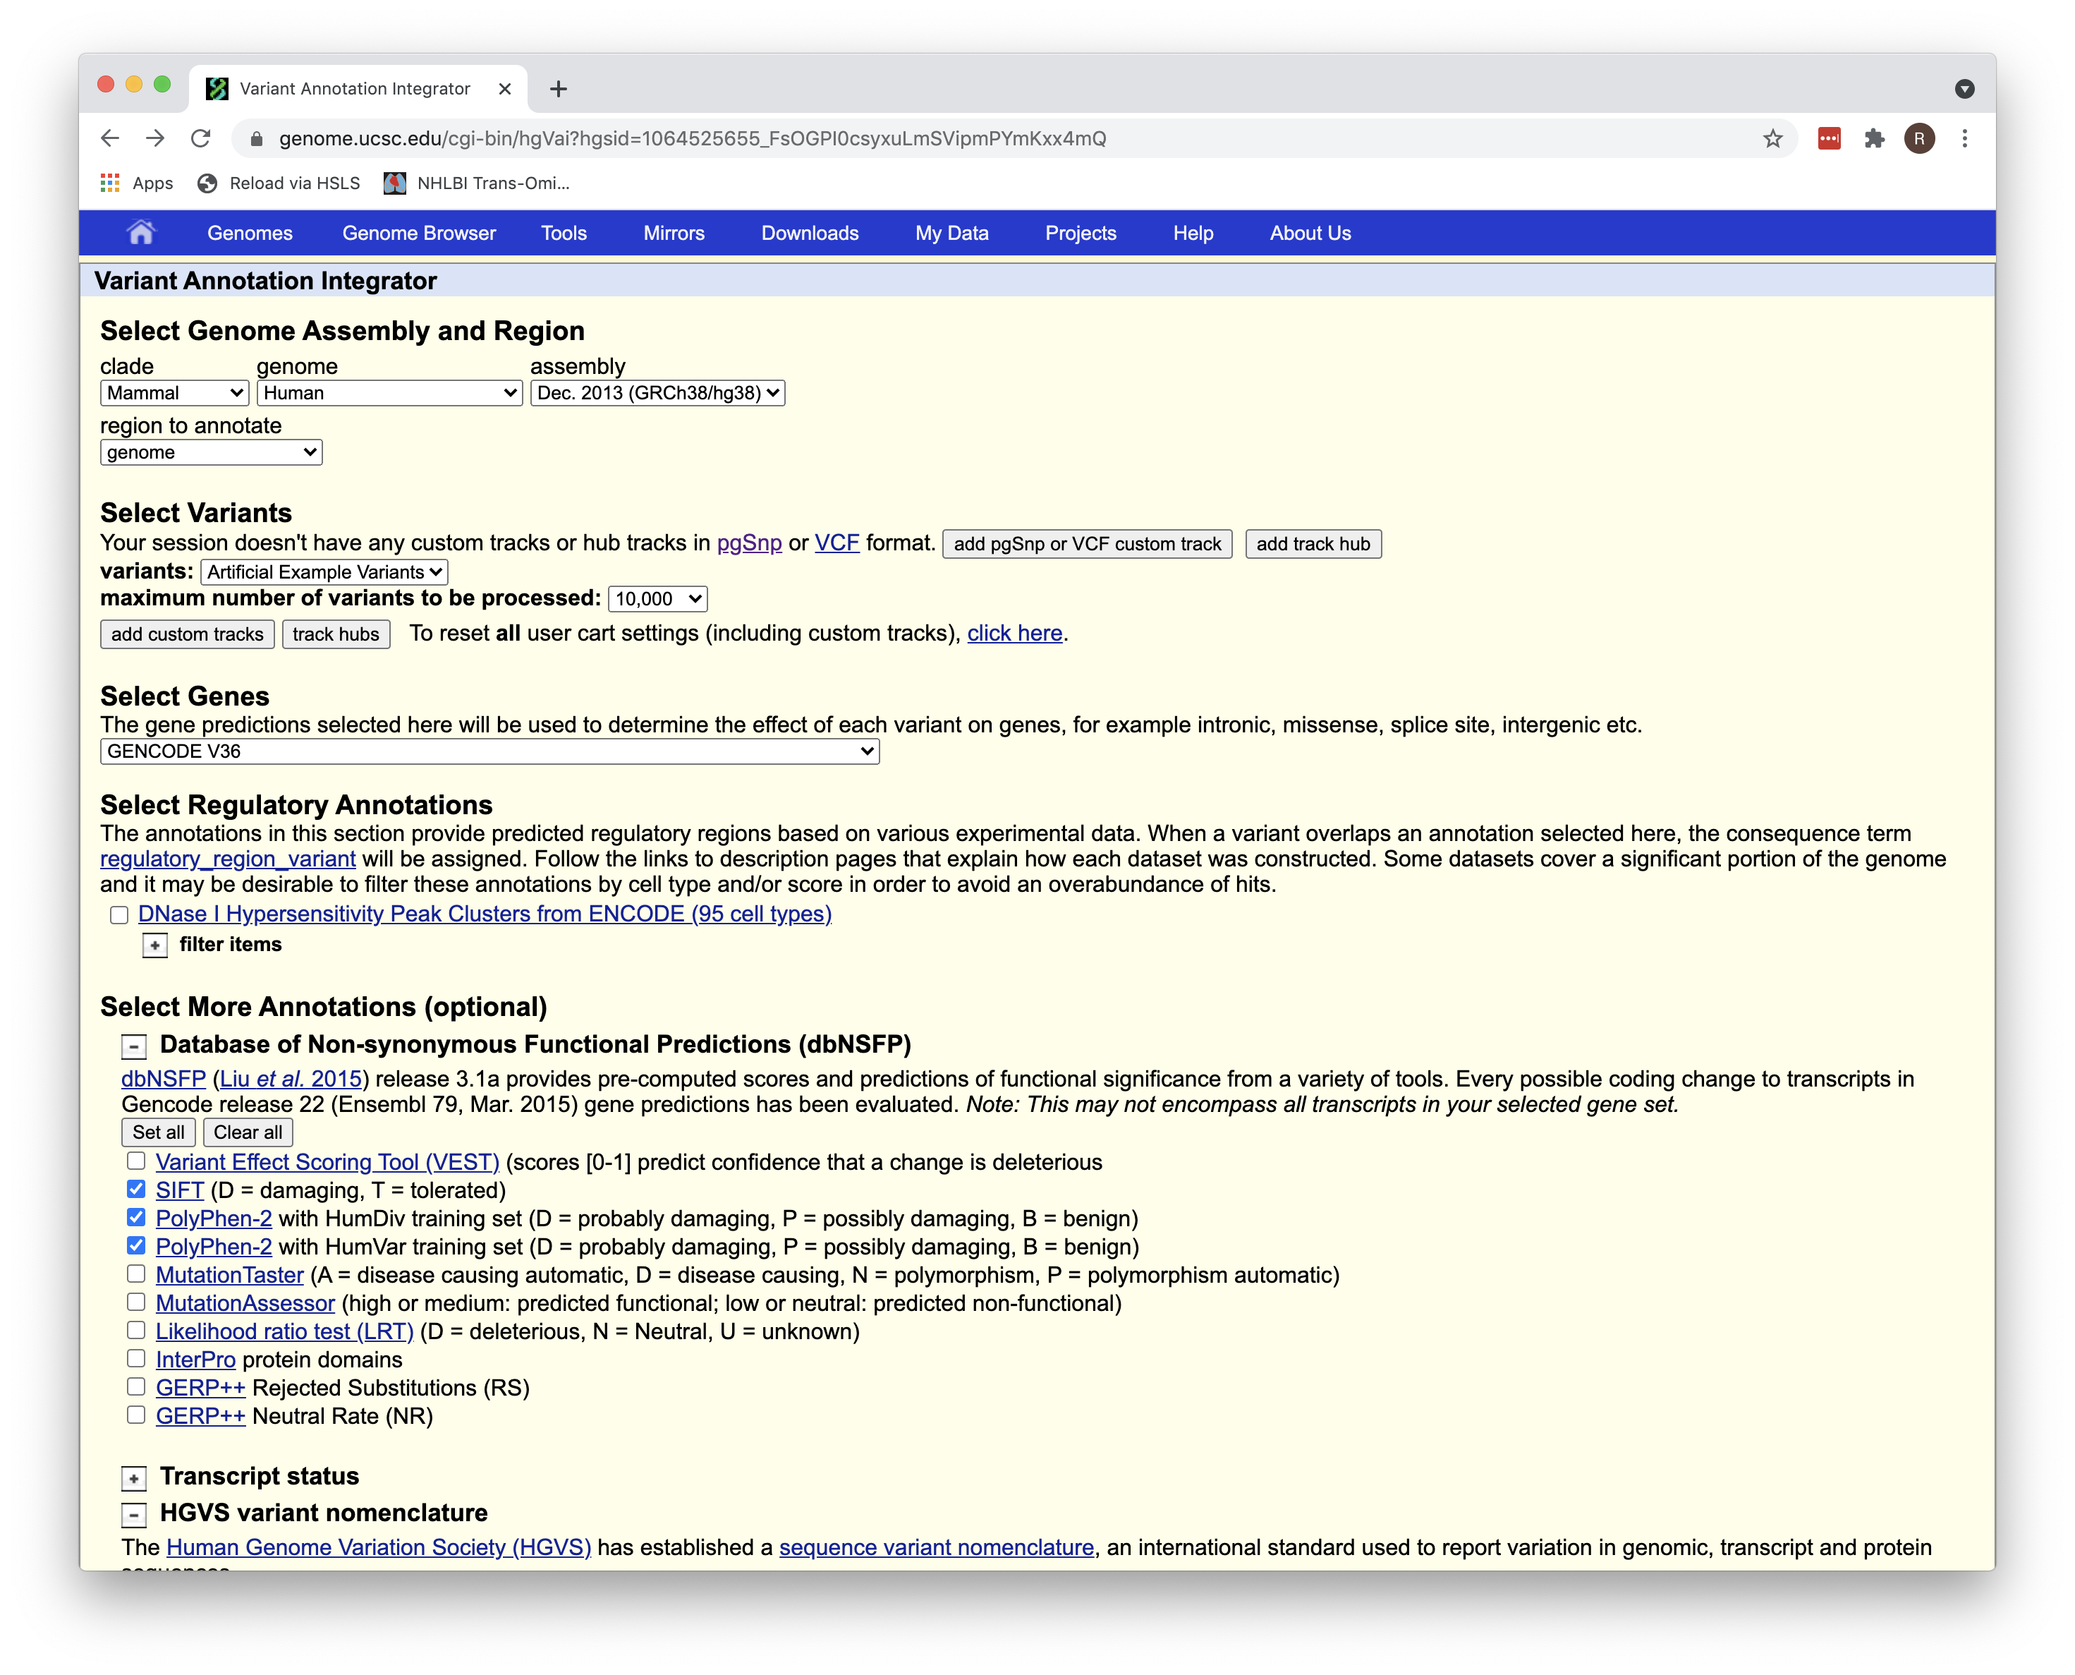
VAI
Site based

Slide 30
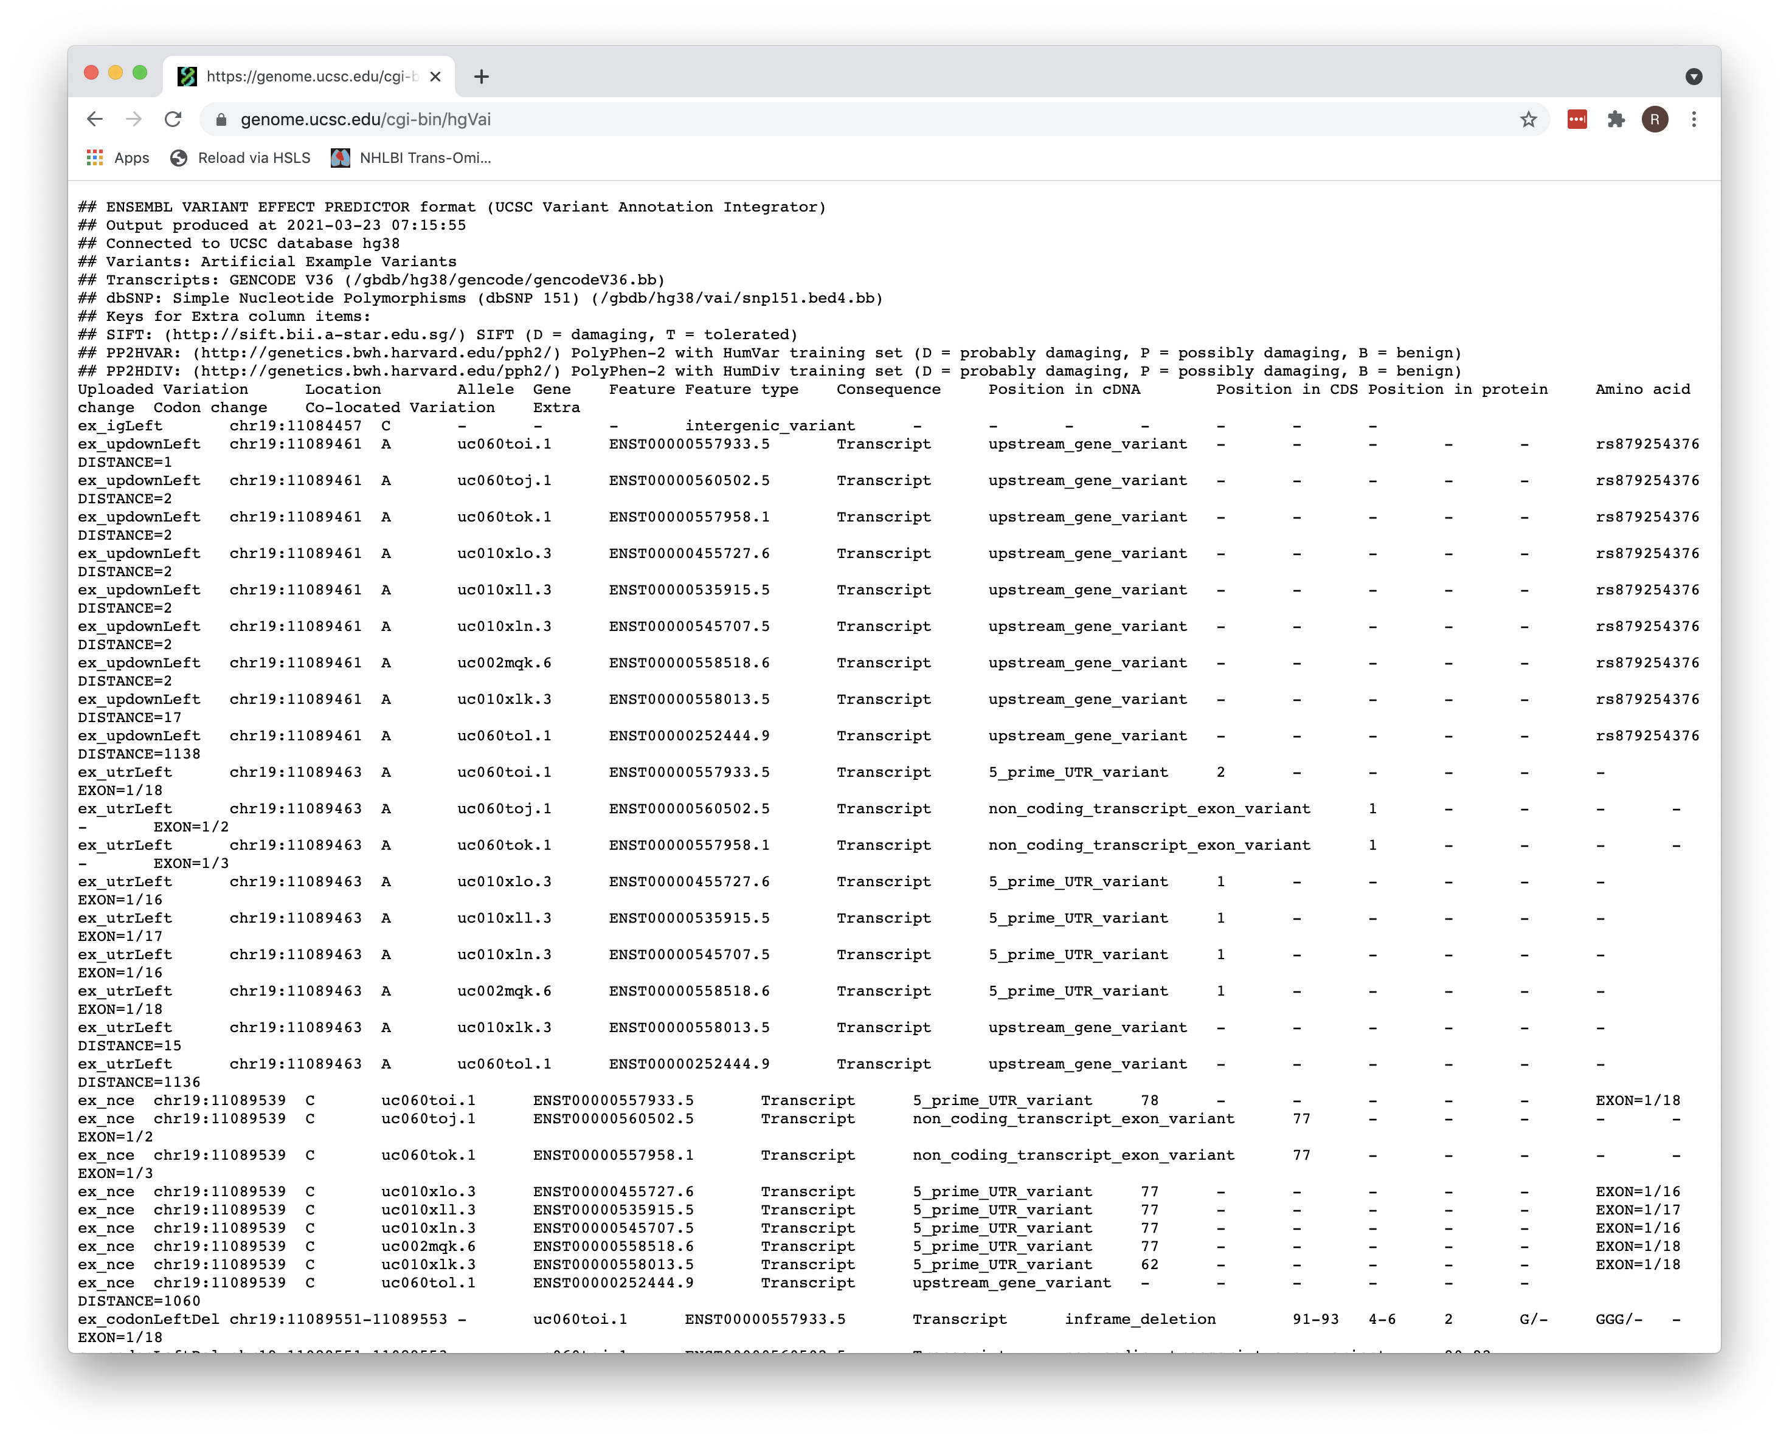
Output

Slide 31
Features
Visual Interface (“Genome Browser” on the landing page)
Underlying Data Tables (“Table Browser”)
Two types of data integrators
Site Based (“Variant Annotation Integrator”)
Range Based (“Data Integrator”)
Desktop version [“Genome Browser in a Box (GBiB)”]
Genome coordinate conversion (“LiftOver”)
Ability to add custom tracks (”Track Hubs”)

Slide 32
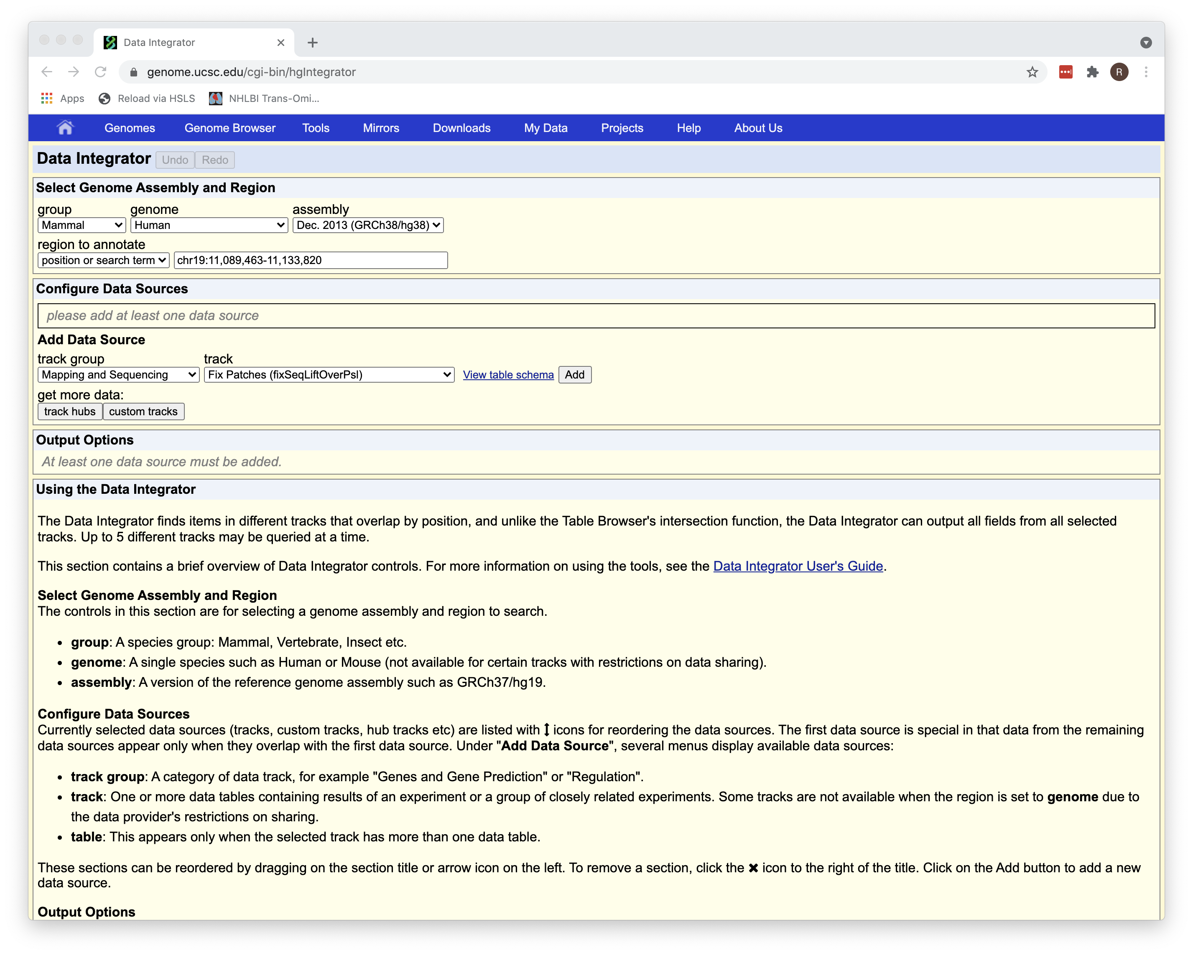
Data Integrator
Range based

Slide 33
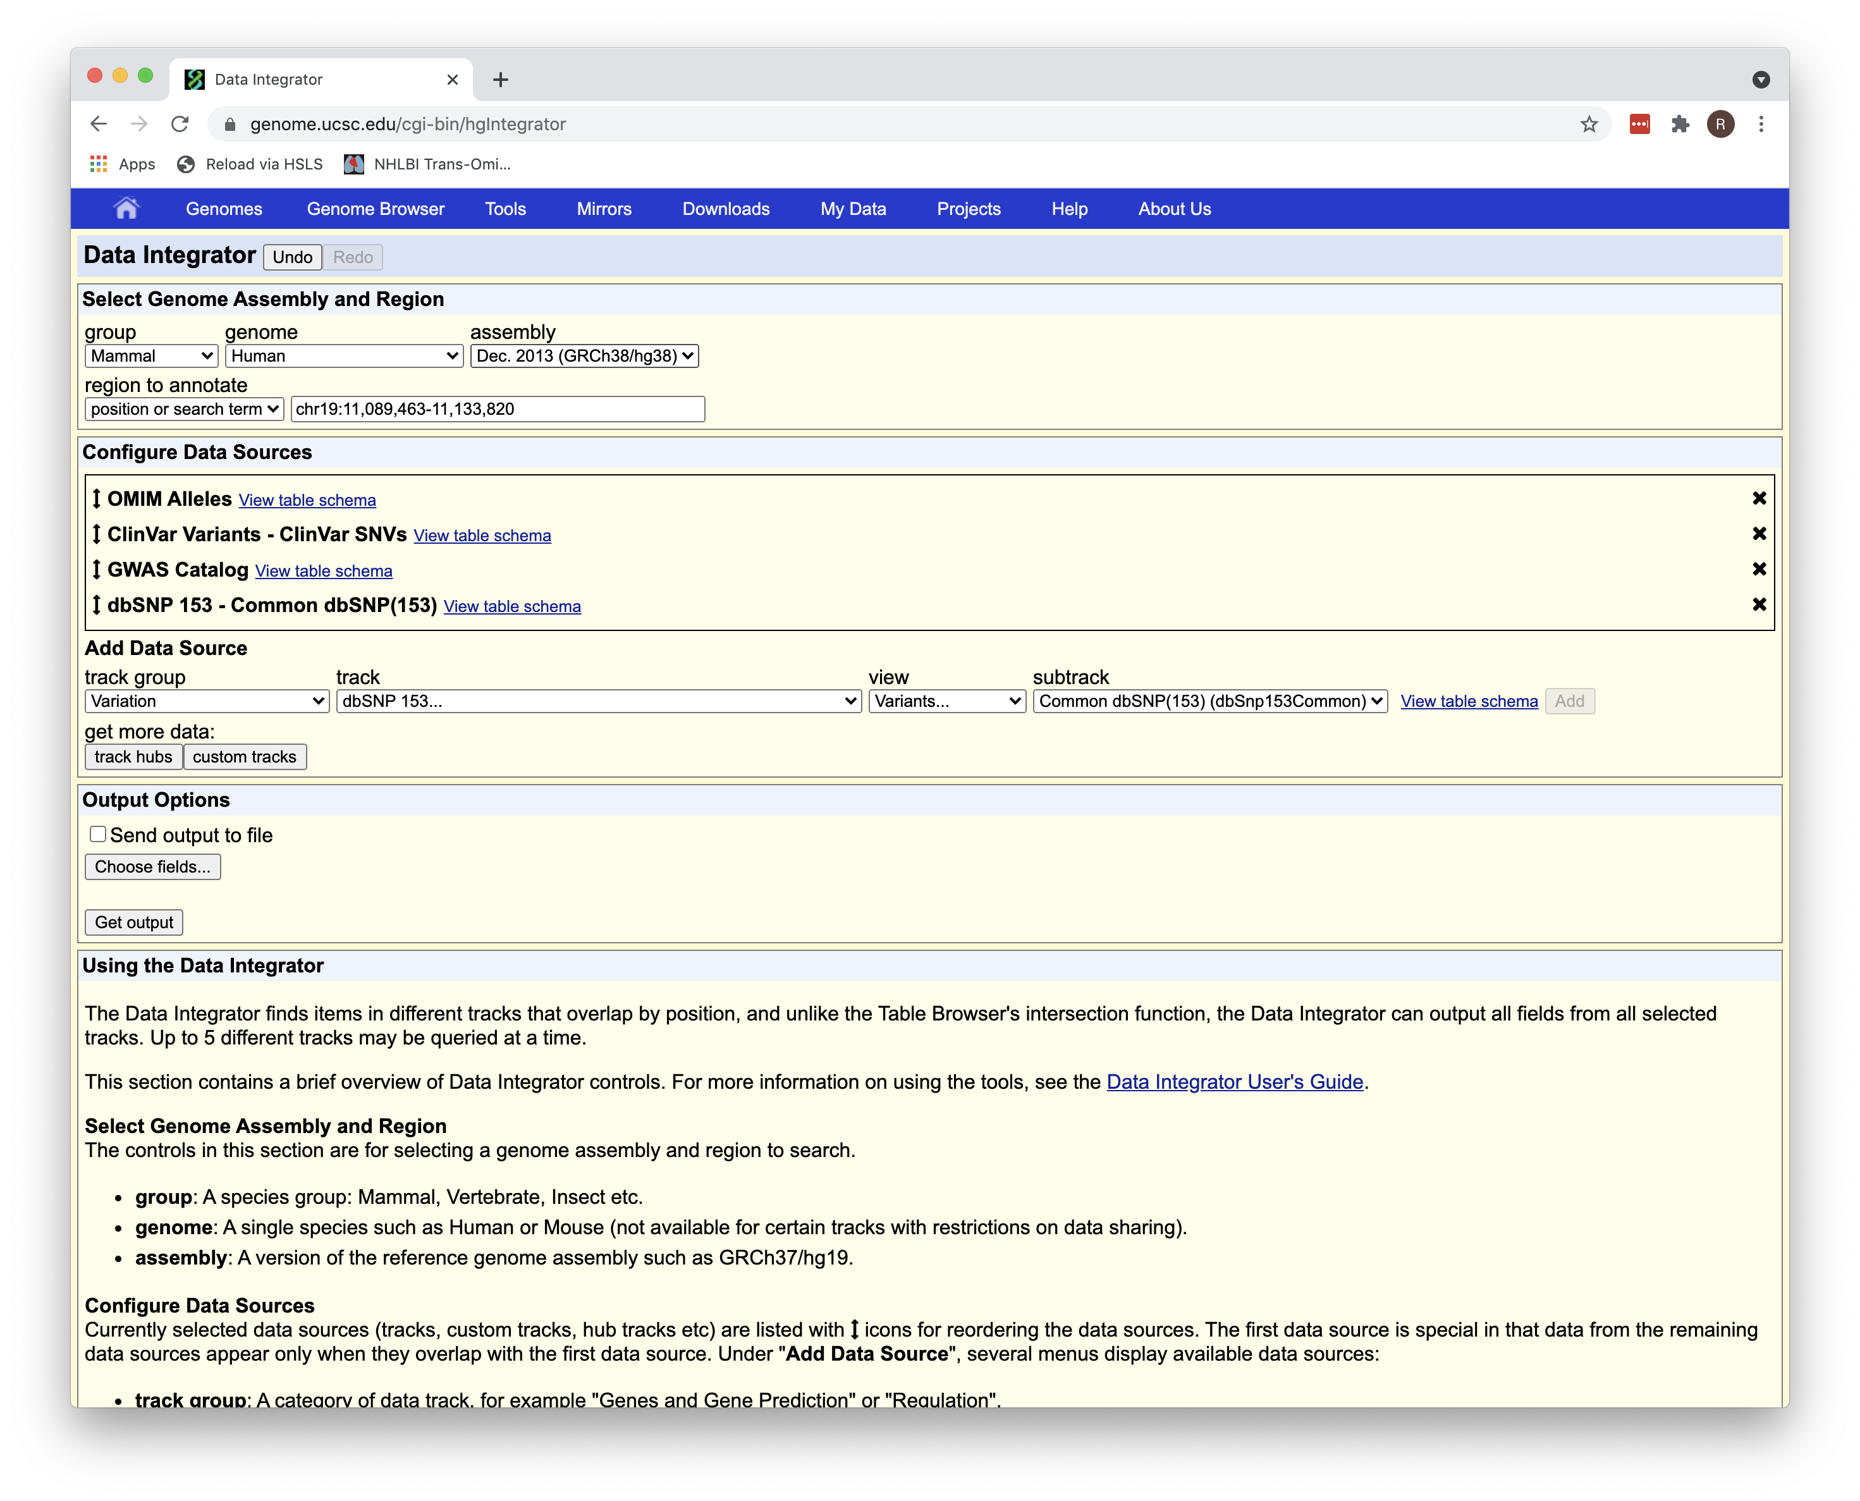
Add tracks

Slide 34
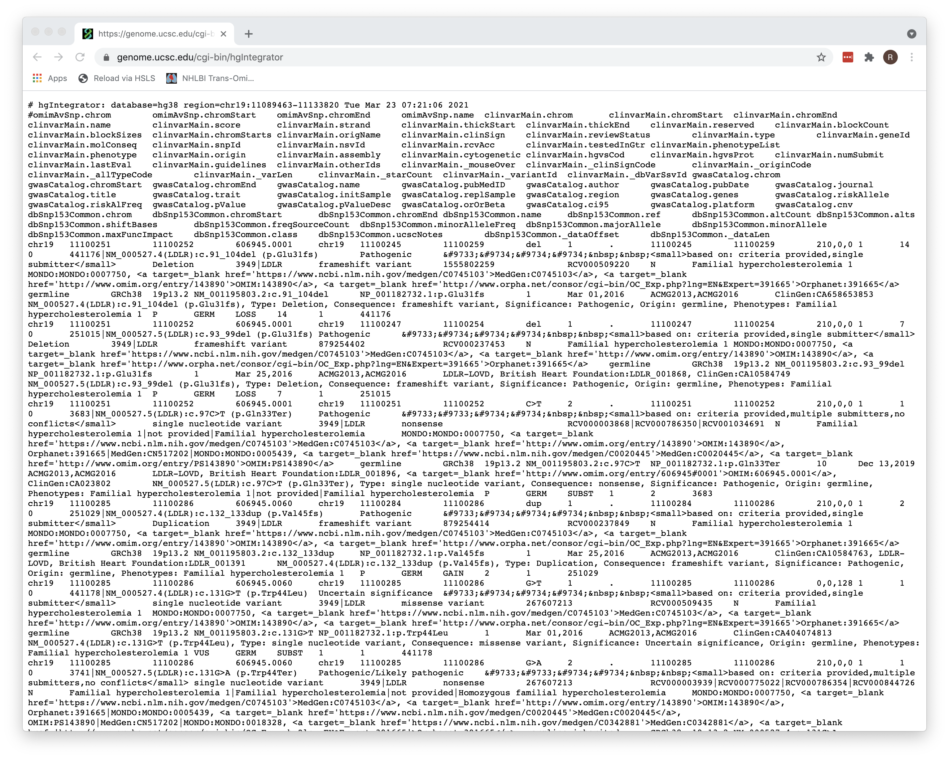
Output

